Slide 1
Introduction to the Architecture of Computers
Professor Hugh C. Lauer CS-2011, Machine Organization and Assembly Language
(Slides include copyright materials from Computer Systems: A Programmer’s Perspective, by Bryant and O’Hallaron, and from The C Programming Language, by Kernighan and Ritchie)

Slide 2
Today
Before electronic computers
Logic and gates
Latches and Registers

Slide 3
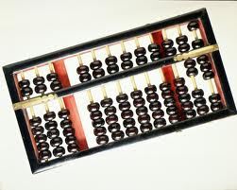
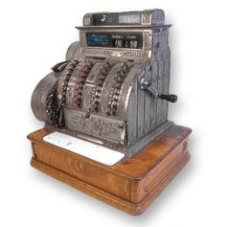
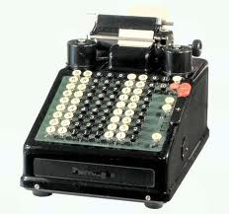
Before electronic computers
Data values represented by positions of beads
Arithmetic by manual algorithm
Arithmetic by rotating wheels and gears
Data values represented by rotational positions of wheels and dials

Slide 4
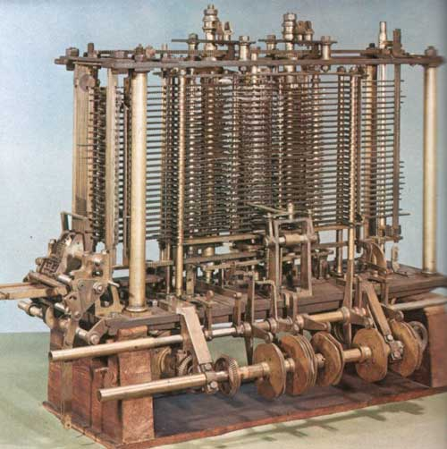
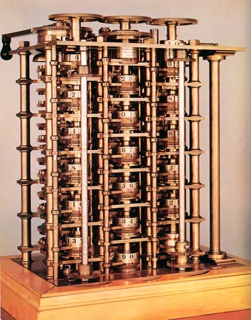
Charles Babbage “engines”
Difference engine
Analytical engine
Data values represented by rotational positions of wheels and dials

Slide 5
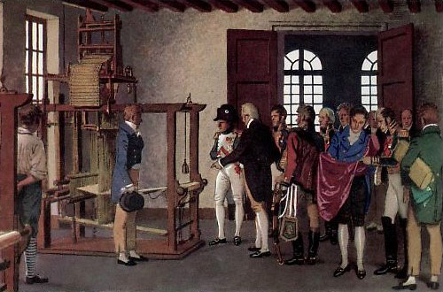
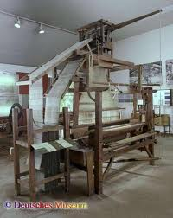
Jacquard Loom
Punched cards for controlling patterns of woven cloth
Punched cards were part of Babbage’s design for data entry and program control

Slide 6
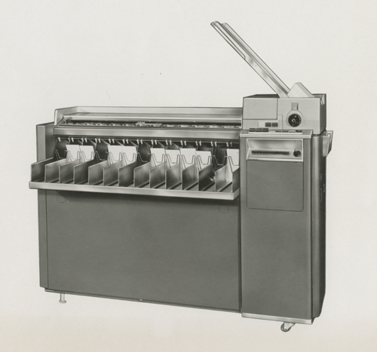
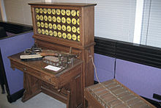
Punched card tabulating equipment
Late 19th century
Mid 20th century
Data stored in trays (i.e., “files”) of punched cards algorithms coded into plug-boards to operate on data, punch new cards, etc.

Slide 7
Today
Before electronic computers
Logic and gates
Latches and Registers
Reading Assignment: §4.2

Slide 8
Overview of Logic Design
Fundamental Hardware Requirements
Communication
How to get values from one place to another
Computation
Storage
Bits are Our Friends
Everything expressed in terms of values 0 and 1
Communication
Low or high voltage on wire
Computation
Compute Boolean functions
Storage
Store bits of information

Slide 9
Digital Signals
0
1
0
Voltage
Time
Use voltage thresholds to extract discrete values from continuous signal
Simplest version: 1-bit signal
Either high range (1) or low range (0)
With guard range between them
Not strongly affected by noise or low quality circuit elements
Can make circuits simple, small, and fast

Slide 10
Computing with Logic Gates
And
Or
Not
a
a
out
out
a
out
b
b
out = a
&
b
out = a
|
b
out =
~
a
Outputs are Boolean functions of inputs
Respond continuously to changes in inputs
With some, small delay
a & b
Rising Delay
Falling Delay
b
Voltage
a
Time

Slide 11
Combinational Circuits
Acyclic Network
Primary
Inputs
Primary
Outputs
Acyclic Network of Logic Gates
Continously responds to changes on primary inputs
Primary outputs become (after some delay) Boolean functions of primary inputs

Slide 12
Bit Equality and Exclusive OR
Bit equal
Exclusive OR
a
a
eq
Xor
b
b
Generate 1 if a and b are equal
Generate 1 if a and b are not equal

Slide 13
Word Equality
Word-Level Representation
b₃₁
Bit equal
eq₃₁
B
=
Eq
a₃₁
A
b₃₀
Bit equal
eq₃₀
a₃₀
and
Eq
b₁
Bit equal
eq₁
a₁
32-bit word size
May be adapted to any word size
b₀
Bit equal
eq₀
a₀

Slide 14
Bit-Level Multiplexor
s
Bit MUX
b
out
a
bool out = (s&a)||(!s&b)
Control signal s
Data signals a and b
Output a when s=1, b when s=0

Slide 15
Word Multiplexor
s
Word-Level Representation
s
B
MUX
b₃₁
Out
out₃₁
A
a₃₁
b₃₀
out₃₀
a₃₀
Select input word A or B depending on control signal s
b₀
out₀
a₀

Slide 16
Decoder
Opposite of Multiplexor
Selects one of 2^{n} outputs from n inputs
=1 if and only if AB = 00
=1 if and only if AB = 01
=1 if and only if AB = 10
=1 if and only if AB = 11

Slide 17
Single-bit adder
A | B | Carry In | Carry Out | Sum
0 | 0 | 0 | 0 | 0 | 0 + 0 + 0 = 00₂
0 | 0 | 1 | 0 | 1 | 0 + 0 + 1 = 01₂
0 | 1 | 0 | 0 | 1 | 0 + 1 + 0 = 01₂
0 | 1 | 1 | 1 | 0 | 0 + 1 + 1 = 10₂
1 | 0 | 0 | 0 | 1 | 1 + 0 + 0 = 01₂
1 | 0 | 1 | 1 | 0 | 1 + 0 + 1 = 10₂
1 | 1 | 0 | 1 | 0 | 1 + 1 + 0 = 10₂
1 | 1 | 1 | 1 | 1 | 1 + 1 + 1 = 11₂
Carry In
+
A
Sum
B
Carry Out

Slide 18
Single-bit adder (cont.)
A | B | Carry In | Carry Out | Sum
0 | 0 | 0 | 0 | 0 | 0 + 0 + 0 = 00₂
0 | 0 | 1 | 0 | 1 | 0 + 0 + 1 = 01₂
0 | 1 | 0 | 0 | 1 | 0 + 1 + 0 = 01₂
0 | 1 | 1 | 1 | 0 | 0 + 1 + 1 = 10₂
1 | 0 | 0 | 0 | 1 | 1 + 0 + 0 = 01₂
1 | 0 | 1 | 1 | 0 | 1 + 0 + 1 = 10₂
1 | 1 | 0 | 1 | 0 | 1 + 1 + 0 = 10₂
1 | 1 | 1 | 1 | 1 | 1 + 1 + 1 = 11₂
C_{in}
B
A
C_{out}
Sum

Slide 19
Multi-bit adder
B_{n-1}
A_{n-1}
B₃
A₃
B₂
A₂
B₁
A₁
B₀
A₀
+
+
+
+
+
C_{n-1}
C₃
C₂
C₁
C₀
S_{n-1}
S₃
S₂
S₁
S₀

Slide 20
Arithmetic Logic Unit (single-bit example)
0
1
2
3
Y
A
Y
A
Y
A
Y
A
A
L
U
A
L
U
A
L
U
A
L
U
X + Y
X - Y
X & Y
X ^ Y
X
B
OF
X
B
OF
X
B
OF
X
B
OF
ZF
ZF
ZF
ZF
CF
CF
CF
CF
Combinational logic
Continuously responding to inputs
Control signal selects function computed
Corresponding to four basic arithmetic/logical operations
Also computes values for condition codes
Figure 4.15 (Not in our textbook)

Slide 21
Modern Arithmetic-Logic Unit (ALU)
Combines
Add
Subtract
And
Or
Not
Xor
Equality
<
>
<<
>>
…
Outputs
Result
CF — Carry flag
ZF — Zero flag
SF — Sign flag
OF — Overflow flag
Result developed within one cycle (300 ps)
Conspicuously absent:– multiplication & division!

Slide 22
Questions?

Slide 23
Today
Before electronic computers
Logic and gates
Latches and Registers

Slide 24
Storing 1 Bit
Bistable Element
q
Q+
!q
Q–
q = 0 or 1
V₂
V_{in}
V₁

Slide 25
Storing 1 Bit (continued)
Bistable Element
q
Q+
!q
Q–
q = 0 or 1
Stable 1
V_{in} = V₂
V₂
V₂
Metastable
V_{in}
V_{in}
V₁
V₁
Stable 0

Slide 26
Physical Analogy
Stable 1
Metastable
Stable 0
Metastable
Stable left
Stable right
.
.
.

Slide 27
Storing and Accessing 1 Bit
Bistable Element
R-S Latch
q
R
Q+
Q+
!q
Q–
Q–
S
q = 0 or 1
Resetting
Setting
Storing
1
1
0
0
0
1
0
!q
q
0
0
1
1
1
0
0
q
!q

Slide 28
1-Bit Latch
D Latch
D
R
Data
Q+
C
Q–
Clock
S
Latching
Storing
d
!d
!d
!d
d
d
!d
0
!q
q
1
0
!q
d
d
!d
0
q

Slide 29
Definition — Clock
A periodic signal consisting of an alternating sequence of ones and zeros at regular intervals
E.g., 333 picoseconds in a modern 3 GHz processor
Purpose:– to control when to capture the result of a logic circuit
E.g., an ALU consisting of AND’s, OR’s, and NOT’s
E.g., a register or memory or other device

Slide 30
Register
Structure
i₇
D
o₇
C
Q+
i₆
D
o₆
C
Q+
i₅
D
o₅
C
Q+
i₄
D
o₄
C
Q+
I
O
i₃
D
o₃
C
Q+
i₂
D
o₂
C
Q+
i₁
D
o₁
Clock
C
Q+
i₀
D
o₀
C
Q+
Clock
Stores word of data
Different from program registers seen in assembly code
Collection of edge-triggered latches
Loads input on rising edge of clock

Slide 31
Register Operation
State = x
State = y
x
Rising
clock
y
Input = y
Output = x


Output = y
Stores data bits
For most of time acts as barrier between input and output
As clock rises, loads input

Slide 32
(Finite) State Machine
A register or latch of n bits representing the “state” of the circuit
An acyclic network of combinatorial logic to compute a new value of n bits based on the existing value of n bits
A clock signal to effect the update of the “state” to a new “state”
Combinational
Logic Circuit
MUX
input
S
AND
Storage
Element
output
clock

Slide 33
Finite State Machine Example
0
1
01
all off
grp 1 on
00
0
DETOUR
1
0
10
0,1
all on
grp 1,2 on
Three groups of lights to be lit in a sequence: group 1 on, groups 1 & 2 on, all groups on, all off.
The lights are on only if the main switch is on.
Four states: so we need two bits to identify each state.
11
1
switch
out1
out2
out3
Combinational
Logic Circuit
S
2
2
d[1:0]
Two bit
Storage
clock

Slide 34
Register File
valA
Register
file
srcA
A
valW
Read ports
W
dstW
Write port
valB
srcB
B
Clock
Stores multiple words of memory
Address input specifies which word to read or write
Register file
Holds values of program registers
%rax, %rsp, etc.
Register identifier serves as address
ID 15 (0xF) implies no read or write performed
Multiple Ports
Can read and/or write multiple words in one cycle
Each has separate address and data input/output

Slide 35
Summary
Data values stored as bits
On wires, in memory cells, etc.
Gates are logic elements that combine values of bits to produce other bits
And, Or, Xor, addition, subtraction, comparison, etc.
Latches capture bit values on wires and keep them until reset
So long as power stays on
Setting of latches is triggered by a clock, which allow data into the latches only when the results of combinatorial logic elements has stabilized.

Slide 36
Questions?
Reading Assignment: §4.2

